Slide 1
Intro to analytical real estate investing

Slide 2
Business Context
Housing Market Size
Opportunity with vrbo, Airbnb or prop mgt to earn revenue

Slide 3
Traditional Real Estate KPI**
Occupancy Rate: Number of booked nights ÷ Number of available nights
Average Daily Rate = Total bookings revenue / total number of nights booked
ALOS = Total number of nights booked ÷ Total number of different guest bookings.
RevPAR = Average daily rate x Occupancy rate (*for multi-unit)
Net Operating Income = Gross Income - Operating expenses
Revenue per property = Gross rental revenue / Total number of available properties for the specific period (multi-unit owners)
Revenue per Channel (VRBO, Airbnb, booking.com)
Inquiry-to-booking conversion rate = Number of inquiries received x total number of bookings for the said property
Average response time to an inquiry = add up the time it took to respond to all your different inquiries / the total number of inquiries you received.
**There are even more!!
**For landlords, different for developers

Slide 4
Some basics – Money In
Monthly Gross Income =
Occupied Nights * Avg Revenue (rental) per Night
Occupied Night – a night an renter has reserved, stays and pays for
Average Revenue – the mean average of the charged renter amount per night of occpancy
6 Nights Rented in October * $50 per night average = $300 Monthly Gross Income

Slide 5
Some basics – Money Out
Monthly Expense= Fixed Costs + Variable Costs
Fixed Costs – Stationary Expenses Incurred (Condo HOA Fees, Internet, etc)
Variable Costs – Costs that fluctuate based on season, occupancy
The more nights your property is rented the more expenses are incurred.
water, electricity, supplies like paper towels & cleaning
October Results
Fixed Cost = $500 HOA + $65 Internet = $565
Var. Cost = $1173
Monthly Expense October = 565+1173 = $1738

Slide 6
More on Variable Costs
Variable costs are not always linear. The more renters the cheaper the expense may become.
Nights Occupied | Number of Renters in Month | Cleaning Costs
6 | 1 | $110
12 | 2 | $95
18 | 3 | $80
When a month only has one renter, you pay the cleaning people once.
When you have 2 renters, you need them twice but negotiate a discount.
When you have 3 renters, the discount increases more than the first discount.

Slide 7
Variable cleaning cost per renter may decrease but…
Nights Occupied | Number of Renters in Month | Cleaning Costs | Total Monthly Cleaning Cost
6 | 1 | $110 | $110
12 | 2 | $95 | $190 (2*95)
18 | 3 | $80 | $240(3*80)
Usually variable unit costs decrease but this can also cause other problems. High usage drives down variable unit cost but increase wear on the property, and things wear out faster like repairing a fridge or replacing carpet.

Slide 8
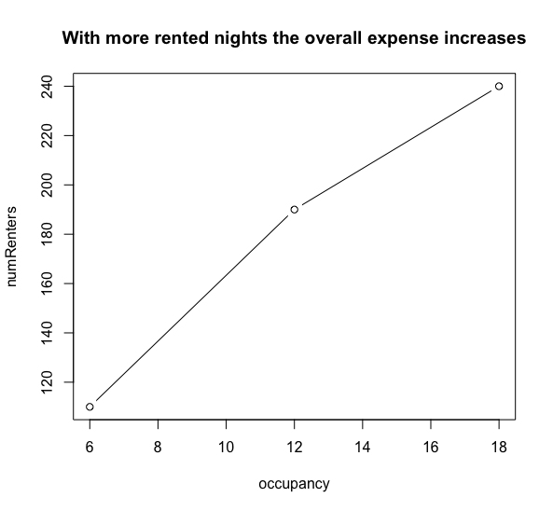
Overall costs increases
Expense of a property = fixed cost + variable cost
Nights Occupied | Number of Renters in Month | Cleaning Costs | Total Monthly Cleaning Cost
6 | 1 | $110 | $110
12 | 2 | $95 | $190 (2*95)
18 | 3 | $80 | $240(3*80)
# Used
numRenters <- 1:3*c(110,95, 80)
plot(occupancy, numRenters,main = 'With more rented nights the overall expense increases', type = 'b')

Slide 9
A Simple Expense Ratio
Operating Expense Ratio
OER = Total Operating Expenses* / Gross Income
OER > 0 = Unprofitable
OER < 0 = Profitable
OER measures the cost to operate the property compared to rental income. When summarizing for a property to compare use the weighted average because not all months have equal occupied nights.
* We are ignoring depreciation

Slide 10
OER Example
Month | Income (Occupied Nights * Avg Rental Charge) | Fixed Costs (costs that don’t change like HOA) | Variable Costs (fluctuating costs) | Net Operating Income | OER
Jan | $795 (15nights*$53) | -250 | -930 | -385 (795-250-930) | 1.48 (250+930) / 795
OER = Total Operating Expenses/ Gross Income
(250+930) / 795
OER = 1.48, unprofitable month.

Slide 11
OER Example Two
Month | Income (Occupied Nights * Avg Rental Charge) | Fixed Costs (costs that don’t change like HOA) | Variable Costs (fluctuating costs) | Net Operating Income | OER
Jul | $4515 (21nights*$215) | -250 | -1050 | 3215 | 0.29 (250+1050) / 4515
OER = Total Operating Expenses/ Gross Income
(250+1050) / 4515
OER = 0.29, profitable month.

Slide 12
Let’s ignore the other months for learning.
Suppose you want one OER for a property for comparison.
Month | Income (Occupied Nights * Avg Rental Charge) | Fixed Costs (costs that don’t change like HOA) | Variable Costs (fluctuating costs) | Net Operating Income | OER
Jan | $795 (15nights*$53) | -250 | -930 | -385 (795-250-930) | 1.48 (250+930) / 795
Jul | $4515 (21nights*$215) | -250 | -1050 | 3215 | 0.29 (250+1050) / 4515
Can you simply average the inputs?
(1.48 + 0.29) / 2 = 0.885
No, you’re equally weighting the two months despite them having different numbers of occupied nights.

Slide 13
Instead take the weighted average
Each Month’s weight corresponds to the number occupied divided by the total number of nights among all months. Then multiply each OER by the weight and sum it to arrive at the single comparison OER for the property.
Month | Income (Occupied Nights * Avg Rental Charge) | Fixed Costs (costs that don’t change like HOA) | Variable Costs (fluctuating costs) | Net Operating Income | OER
Jan | $795 (15nights*$53) | -250 | -930 | -385 (795-250-930) | 1.48 (250+930) / 795
Jul | $4515 (21nights*$215) | -250 | -1050 | 3215 | 0.29 (250+1050) / 4515
# Weights in the data
oer <- c(1.48, 0.29)
jan <- 15 / sum(15, 21) #.416
jul <- 21 / sum(15, 21) #.583
weighted.mean(oer, c(jan, jul)) #0.7858333
sum(oer * (c(15, 21)/ sum(c(15, 21)))) #0.7858333

Slide 14
A simple income to price based ratio
Capitalization Rate
Cap Rate = Net Operating Income / Total Cost of Ownership (not including interest)
Cap Rate higher is better
Fluctuating income represents volatility in the investment reward.

Slide 15
Prop ID | Fixed | Variable | Total Expense | Operating Income | Net Operating Income (NOI) | Asking Price | Cap Rate
1 | $1,000 | $1,000 | $2,000 | $7,000 | $5,000 | $100,000 | 5% $5K /$100k
2 | $1,000 | $1,000 | $2,000 | $22,000 | $2,0000 | $200,000 | 10% $20k/$200K
3 | $5,000 | $7,000 | $12,000 | $67,000 | $55,000 | $550,000 | 10% $55k/$550k
4 | $500 | $3125 | $3,625 | $13,000 | $9,375 | $75,000 | 12.5% $9,375/ $75K

Slide 16
Ratios help you reduce the opportunities
Prop ID | Operating Expense Ratio – Less than 0 is profitable Total Operating Expenses/ Gross Income | Cap Rate - Higher is Better Income / Total Cost of Ownership | Comment
PropA | 0.9 | 5% | Profitable but priced high for the income
PropB | 0.9 | 10% | Profitable, more fairly priced
PropC | 1.8 | 10% | High expenses (like an old property needing a lot)
PropD | 0.9 | 12.5% | Profitable, income to price of property is the best
PropE | 1.01 | 15% | Break even property, high income to cost. Buy if you can reduce expenses.
These would be aggregated up from monthly information for a comparison.
These are made up numbers, location impacts what is “good” for these KPI.

Slide 17
Open D_exampleRentalData.R

Slide 18
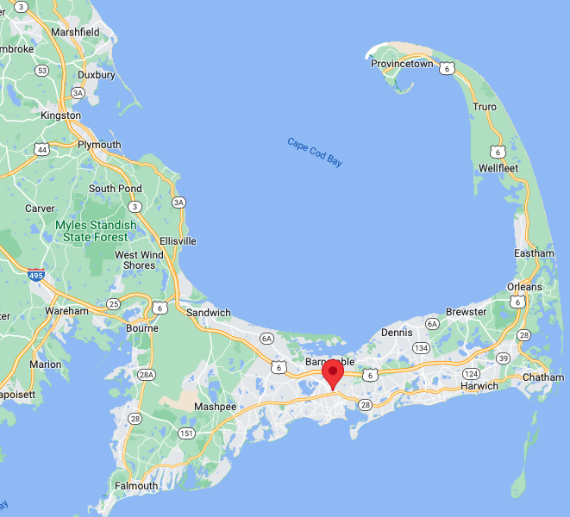

Cape Cod, MA
Cape Cod is a popular summertime destination. It's the site of quaint villages, seafood shacks, lighthouses, ponds and bay and ocean beaches.

Slide 19



Slide 20

Failing to catch a change in market conditions
-No monitoring & governance?! Def an issue
Not public
-Human Override or Algo [greed]; managers and buyers kept overriding decisions in a hot market
-AI w/o governance is a nice scapegoaton earnings calls since analysts don’t know ML
https://insidebigdata.com/2021/12/13/the-500mm-debacle-at-zillow-offers-what-went-wrong-with-the-ai-models/

Slide 21
Investment thesis.
One could buy a property there, rent it out consistently, since it’s a “family tradition” it could be recession proof and there is off-season utility.
Risk
No acceptable prices (market efficiency)
House prices go down
Rental market shrinks/new destinations more popular
Global warming
Reward
Rental Income
Utility of using the property off-season

Slide 22

Risk
No acceptable prices
House prices go down
Rental market shrinks/new destinations more popular
Global warming
Risk Mitigation
No acceptable prices – model appropriate prices, drivers to understand the market & spot value
House prices go down – expect to own the property 10yrs (2008 financial crisis Cape Cod was mostly steady, 2009 was similar)
Rental market shrinks/new destinations more popular – YoY families go to the same town, East coast tradition to “summer” there. Human behavior may limit this.
Global warming – don’t buy in a flood zone, it’s irresponsible for taxpayers, additional insurance, and protects the property

Slide 23
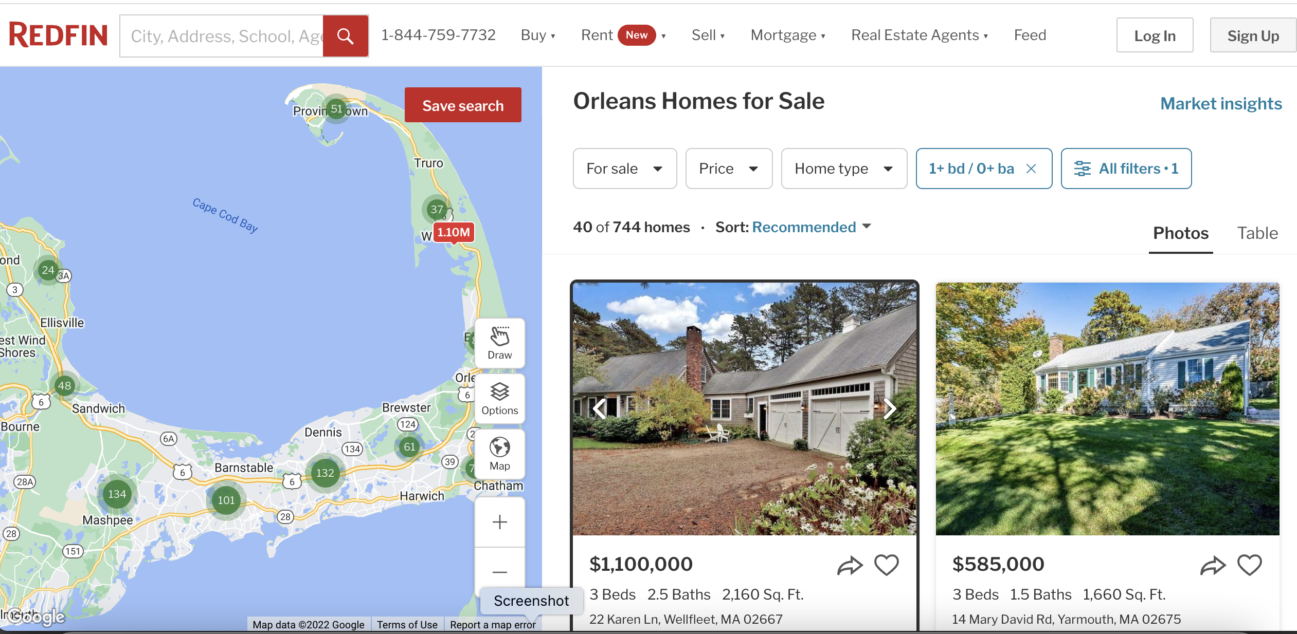
But there are so many properties!

Slide 24
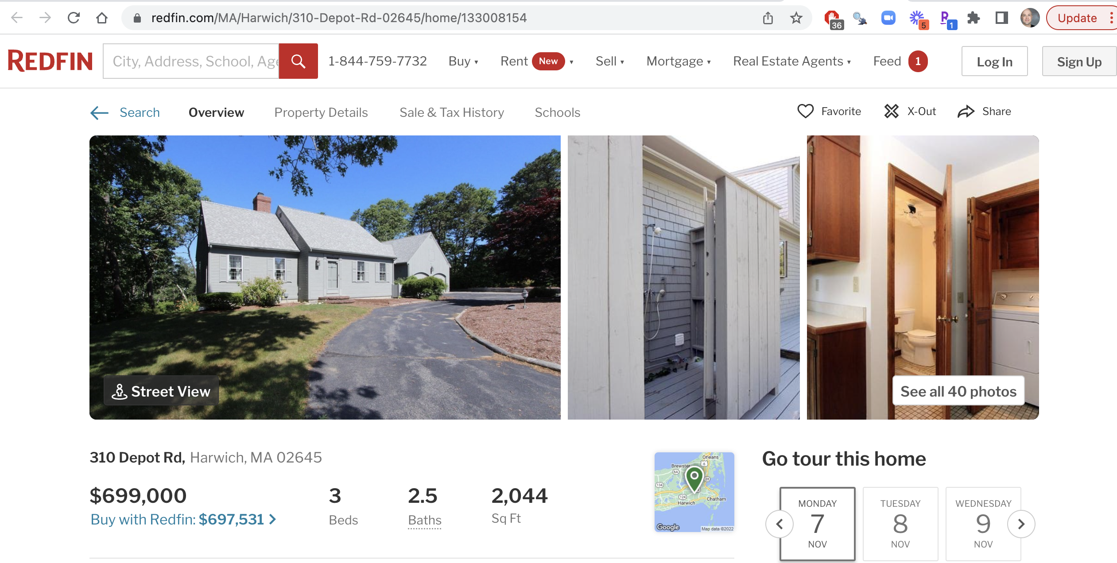
Example property
https://www.redfin.com/MA/Harwich/310-Depot-Rd-02645/home/133008154

Slide 25
Summary
Real estate is a data rich environment.
One can apply common and widely used ratios to identify investment possibilities.
- Since its widely used, it may be hard to identify them before others (one can incorporate other aspects like “sweat equity”)
ML can help identify over and under priced homes. This may help you identify opportunities others relying solely on intuition, qualitative and common ratios may have missed.
- Location, location, location
- Temporal and macro economic modeling may be challenging to this approach

